Slide 1
Digital Portfolio
STUDENT NAME: ANITHA . T
REGISTER NO: 20624U18007
NMID: 547753CB64EC592A3734CEB691AF814
DEPARTMENT: Computer science
COLLEGE: Kamban college of arts and science for women /
Thiruvallur University

Slide 2

PROBLEM STATEMENT
Mathematical operations like addition, subtraction, multiplication, and division are vital in daily life. Manual calculations, however, are often slow and error-prone, especially with large or complex expressions. To address this, the proposed calculator project offers a simple, efficient, and user-friendly solution that ensures accurate results, saves time, and supports basic to moderate operations through an interactive interface.

Slide 3
PROJECT TITLE
INTERACTIVE DIGITAL PORTFOLIO USING FRONTEND WEB DEVELOPMENT

Slide 4


AGENDA
Problem Statement
Project Overview
End Users
Tools and Technologies
Portfolio design and Layout
Features and Functionality
Results and Screenshots
Conclusion
Github Link
3/21/2024 Annual Review

Slide 5

PROJECT OVERVIEW
This project is a basic calculator web app built using HTML, CSS, and JavaScript.
It performs operations such as:
Addition
Subtraction
Multiplication
Division
Modulus
Features: AC (Clear), DEL (Delete), Decimal input.

Slide 6

WHO ARE THE END USERS?
Students: quick math calculations.
Teachers: simple tool in classrooms.
General Users: anyone needing an online calculator.

Slide 7

TOOLS AND TECHNIQUES
HTML5 → Structure and layout
CSS3 → Styling and UI design
JavaScript (ES6) → Logic & interactivity
Text Editor → (VS Code)
Browser → (Chrome/Edge/Firefox)

Slide 8
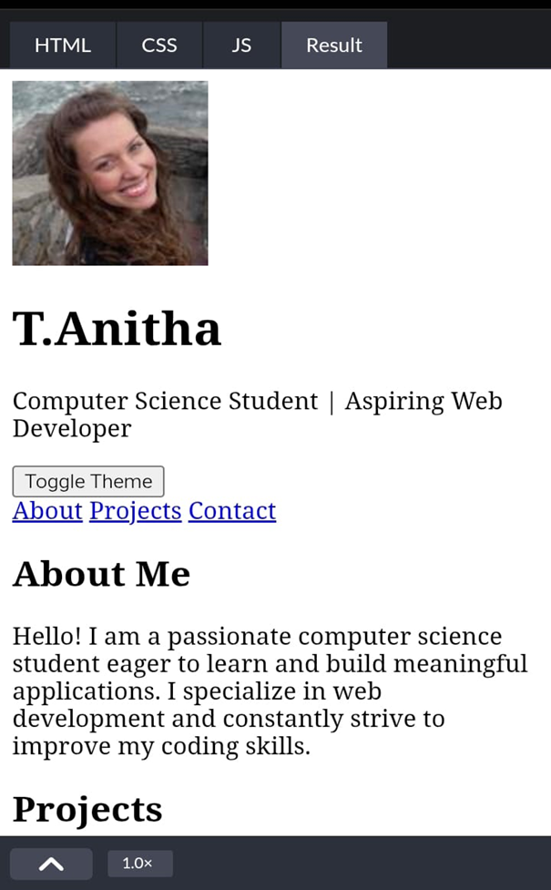
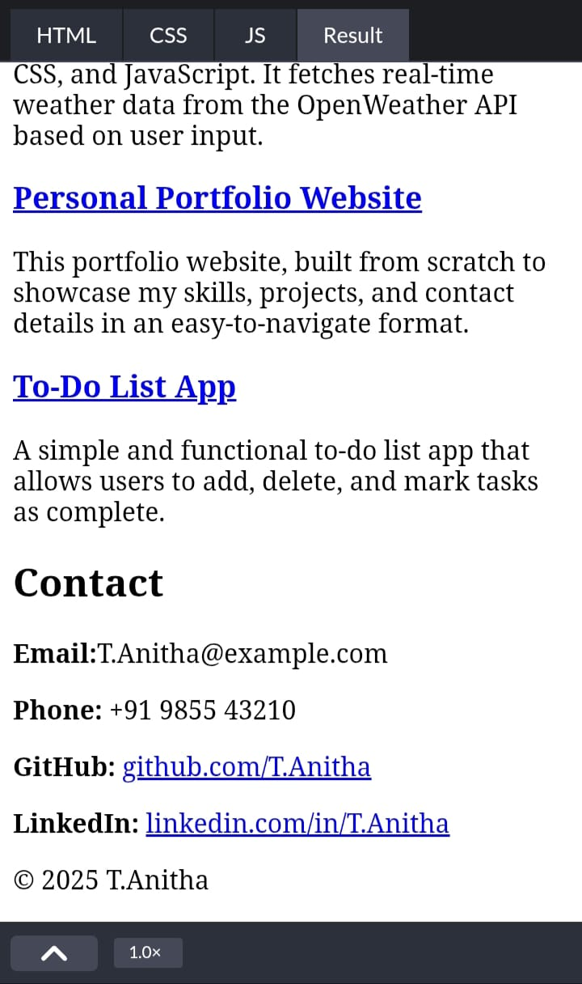
POTFOLIO DESIGN AND LAYOUT
8

Slide 9
FEATURES AND FUNCTIONALITY
Perform basic arithmetic operations
Delete last digit using DEL
Reset calculation using AC
Support for decimal values
Real-time output display

Slide 10
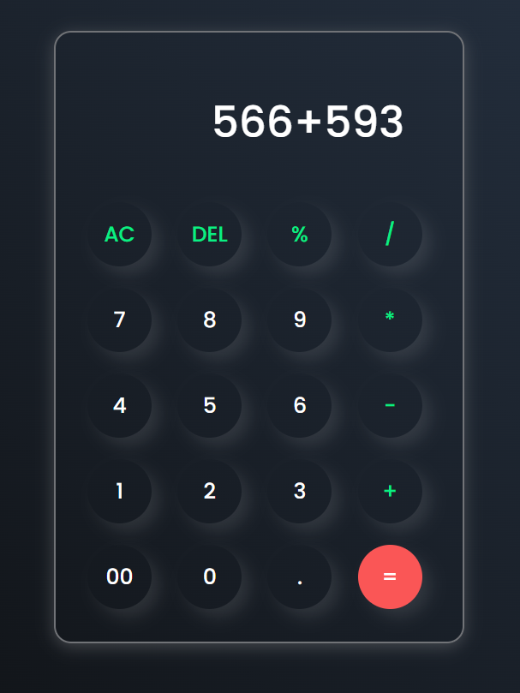
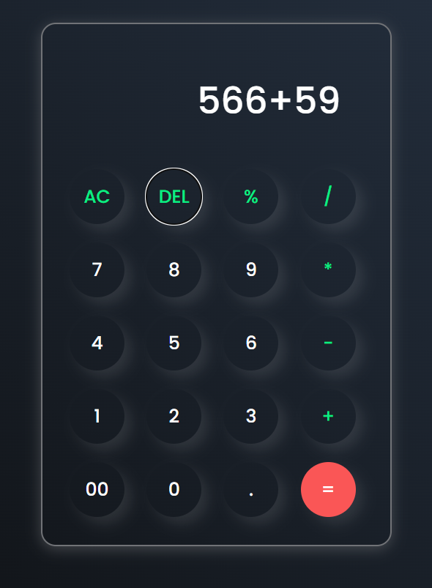
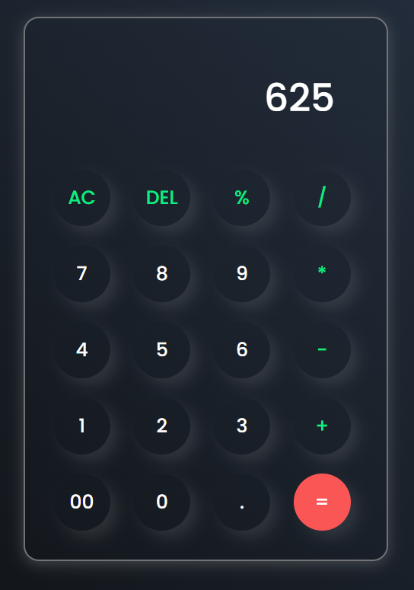

RESULTS AND SCREENSHOTS
8/28/2025 Annual Review
10

Slide 11
CONCLUSION
The calculator project demonstrates the implementation of a simple and efficient tool for performing basic arithmetic operations such as addition, subtraction, multiplication, and division. It offers an easy-to-use interface, reduces manual errors, and improves accuracy and speed in solving problems. Through this project, I gained practical experience in programming, logic building, and user interface design. The calculator also provides a foundation for future enhancements, such as scientific functions, history tracking, and memory features.
11

